Slide 1

Agile Presentation
Tierney Shaughnessy

Slide 2
Scrum-Agile approach
The Scrum – Agile approach is operated in sprints, short and adaptable cycles that allow for adaptation and collaboration. It also allows for testing as you go rather than getting too far ahead and having to fix a mountain of errors.
There are four common stages or events of the sprint. Sprint Planning, Daily Scrums, Sprint Review, and Sprint Retrospective.
There are three sprint roles in these sprints – the Product Owner, the Scrum Master, and the Development Team. These roles have very specific duties and often times overlap in some areas.

Slide 3
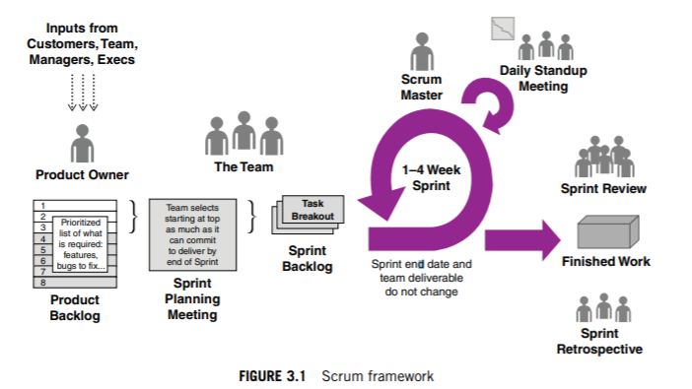
Scrum Framework
(Wiley, 2015)

Slide 4
Product Owner
The Product Owner has many responsibilities, including “maximizing the value of the product and the work of the Development Team.” (Wiley, 2015)
This also includes:
Expressing the Product Backlog Items clearly
Being the Liaison between the Scrum Team and the Client and Users
Organizing the Product Backlog to keep everyone on track to achieve goals and missions
Making sure the Product Backlog is visible and easy to understand

Slide 5
Scrum Master
The Scrum Master ensures that the Scrum-Agile method is understood and that everyone is kept on track. They also oversee the Daily Scrum and ensure that everyone stays on topic! The Scrum Master also works with the Product Owner in many ways:
Helps the entire team understand the need for clear and specific Product Backlog items.
Finds new ways to keep effective management of the Product Backlog
Ensures the Product Owner is able to arrange the product backlog to maximize value (Wiley, 2015)

Slide 6
Development Team
The Development Team is a group of profezsionals who do the work of creating a potentially releasable increment of “done” products at the end of each sprint. Only the Development Team does this. (Wiley, 2015)
Some of the traits of the Development Team are:
Development Teams often share functions, having all the skills as a team necessary to produce a product increment.
Scrum technically does not recognize any other titles for Development Team aside from Developer. There are no exceptions to this, regardless of the work actually being performed. Individual members may have special skills, but ultimately accountability is a team job,
The Development Team organizes themselves. Not even the Scrum Master will tell the team how to turn backlog into increments.

Slide 7
Sprint Planning
Sprint Planning is a meeting that takes place prior to all sprints. In this, the product owner and the team negotiate what stories will be addressed in the sprint and the team decides how many stories will be completed in the sprint.
This is very important as it sets the duties and user stories that will be worked on and keeps everyone in the loop and in the decision. There are various methods of planning as well.

Slide 8
Daily Scrums
The Daily Scrum is a 15-Minute time restricted event for the Development team to coordinate activities and plan out the next 24 hours. (scrum.org, 2020(1))
The scrum is held at the same time, in the same place, and held each day to encourage simplicity for this event. The team uses the daily scrum to examine progress towards the Sprint Goal and how progress is headed towards the work in the Sprint Backlog.
This also encourages teamwork and communication as any hurdles or problems can be addressed and team members can request help. It also means everyone is on the same page.

Slide 9
Sprint Review
The Sprint Review is a Scrum Event that is held at the end of the Sprint. The team inspects the increment and adapts the Product Backlog if necessary.
The Scrum Team and Stakeholders collaborate about what happened in the Sprint and based on any changes to the backlog and that collaboration, the review team collaborates further on what could be done in the next sprint to optimize value.
It is very informal, not a status meeting but a collaboration. (scrum.org, 2020 (3))

Slide 10
Sprint Retrospective
The Sprint Retrospective is held after the Sprint Review and before the next Sprint Planning event. At most, it is three-hours for one-month sprints. Anything shorter, the retrospective is shorter as well.
The Scrum Master makes sure the retrospective takes place and that everyone present understands why they are there. This is an opportunity for the entire team to improve and all members should be present. (scrum.org, 2020 (3))
The team will discuss:
What went well in the Sprint
What could be improved upon
What the team will decide to improve upon in the next sprint.

Slide 11
Agile vs Waterfall
The main difference between an Agile approach and a Waterfall approach in my opinion is that errors would be caught far earlier. With a waterfall approach, it’s entirely possible we’d wind up having to redo a large amount of programming – while an agile approach would catch that much sooner.
With Agile, you edit as you go – and so that is another difference between Agile and Waterfall approaches.
In choosing which approach, I would consider what the project needs are – some projects might be better suited to either approach, after all. If I need more adaptability, I’d go with agile. If I don’t need a whole

Slide 12
References
Cobb, C. G. (2015). The project manager's guide to mastering agile: Principles and practices for an adaptive approach. Hoboken, NJ: John Wiley.
What is a Daily Scrum? (2020). Retrieved December 16, 2020, from https://www.scrum.org/resources/what-is-a-daily-scrum (1)
What is a Sprint Review? (2020). Retrieved December 16, 2020, from https://www.scrum.org/resources/what-is-a-sprint-review (2)
What is a Sprint Retrospective? (2020). Retrieved December 16, 2020, from https://www.scrum.org/resources/what-is-a-sprint-retrospective (3)

